Slide 1
Vehicular Network Analysis Using Probabilistic Model Checking
Jonathan Lo, Tommaso Peletta
3 Juin 2021

Slide 2
Goal of the project
Using probabilistic model checker to analyse vehicular network

Slide 3





A Probabilistic Model Checker
Model
Model Checker
Result
$$φ$$
Properties

Slide 4
PRISM
Probabilistic Model Checker
Analyse : probabilistic, nondeterministic and real-time characteristics
Free and open source

Slide 5



PRISM : application domain
Automotive
system
Wireless
communication
Randomised security protocol

Slide 6
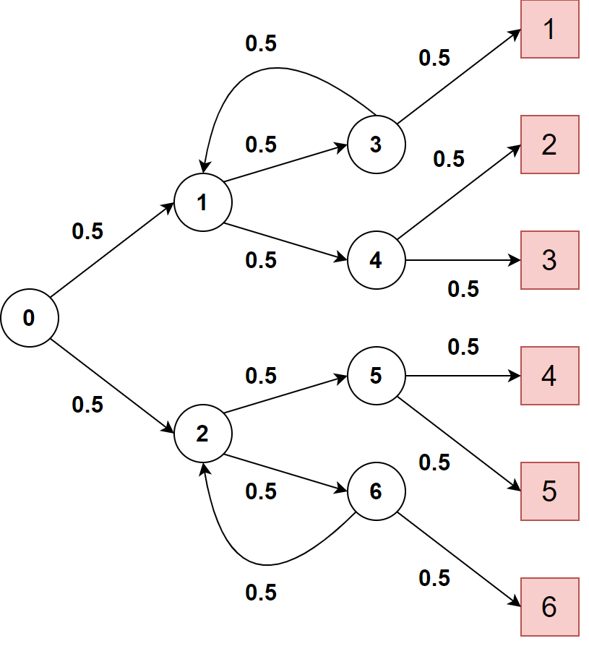
PRISM : Example
Properties
P = ? [ F s = 7 and d = x]
R = ? [F s = 7]
s : current state
d : final value

Slide 7
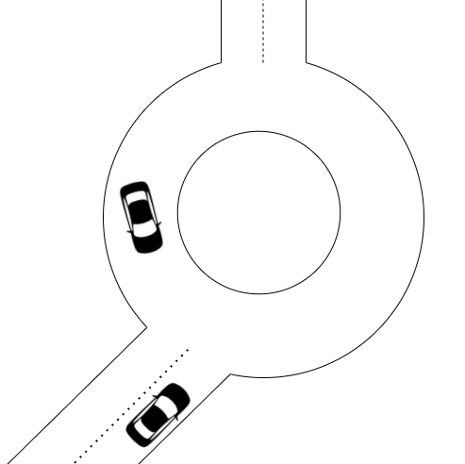
Roundabout Insertion Analysis
Model
Single lane roundabout
Mix of driver and autonomous vehicle
Non-deterministic initial state and behaviour

Slide 8
Roundabout Insertion Analysis
Properties
Collision probability
Overall braking
Time before insertion

Slide 9





Stochastic Cellular Automata
Vehicle H simplification
Vehicle A simplification
Vehicle H size
Intersection
Vehicle A size

Slide 10

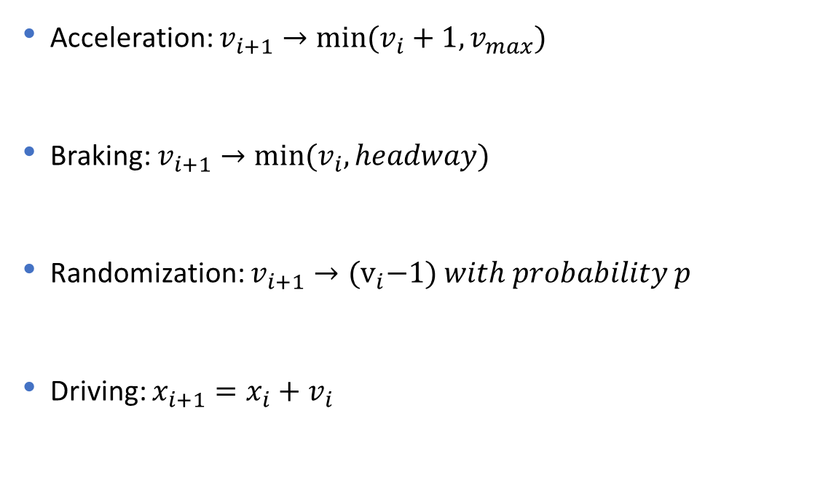
Nagel-Schreckenberg Model
Acceleration: $v_{i+1}→min⁡(v_{i}+1, v_{max})$
Braking: $v_{i+1}→min⁡(v_{i}, headway)$
Randomization: $v_{i+1}→{(v}_{i}−1) with probability p$
Driving: $x_{i+1}=x_{i}+v_{i}$
$$⁡$$

Slide 11
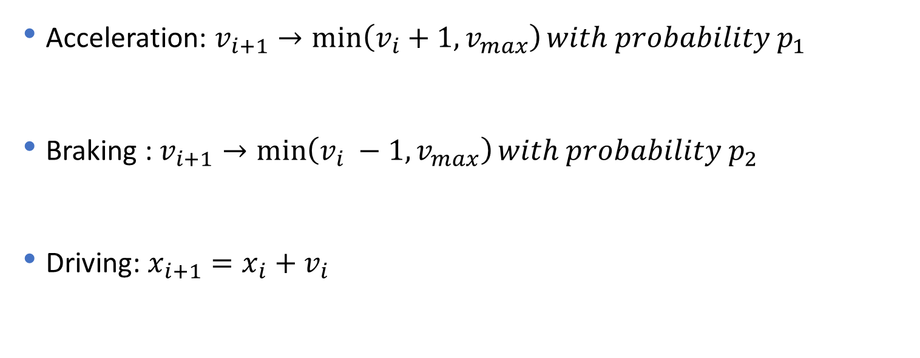
Nagel-Schreckenberg Modified
Vehicle H
Acceleration: $v_{i+1}→\min\left(v_{i}+1, v_{max}\right)with probability p_{1}$
Braking : $v_{i+1}→\min\left(v_{i} −1, v_{max}\right)with probability p_{2}$
Driving: $x_{i+1}=x_{i}+v_{i}$
$$⁡$$

Slide 12
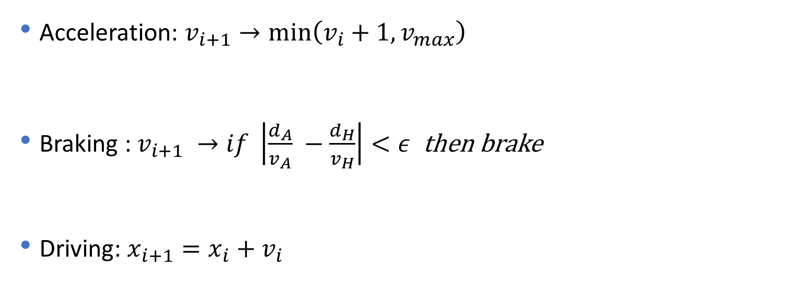
Nagel-Schreckenberg Modified
Vehicle A
Acceleration: $v_{i+1}→\min\left(v_{i}+1, v_{max}\right)$
Braking : $v_{i+1} →if \left|\frac{d_{A}}{v_{A}} −\frac{d_{H}}{v_{H}}\right|<ε$ then brake
Driving: $x_{i+1}=x_{i}+v_{i}$
$$⁡$$

Slide 13
Roundabout Insertion Analysis
Problems
Not suited for a probabilistic model checker
Arificial parameters
Modelling problem

Slide 14
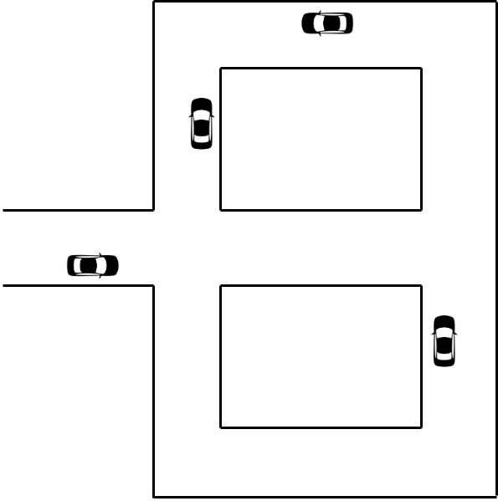
Road topology
Goal
Analyze vehicular traffic
Overloaded road
Find solution to improve traffic flow

Slide 15
Road topology
Model
Portion of a roadmap
Initial configuration predetermined
Road divided in segments with different travel time
Same probability

Slide 16
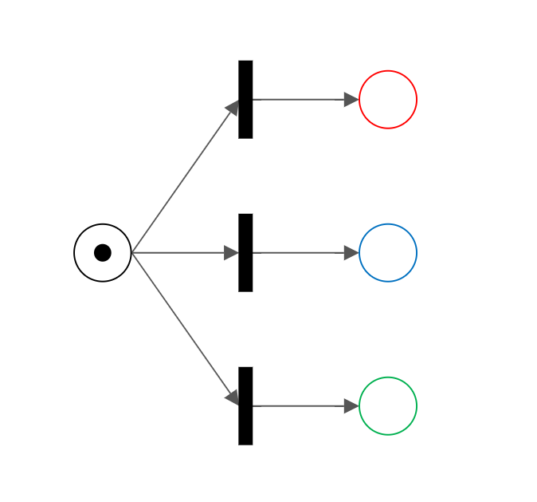
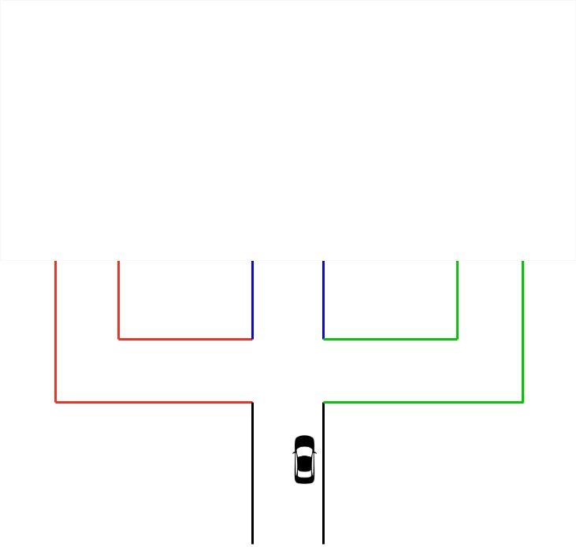
Petri Net
1/3
1/3
1/3

Slide 17
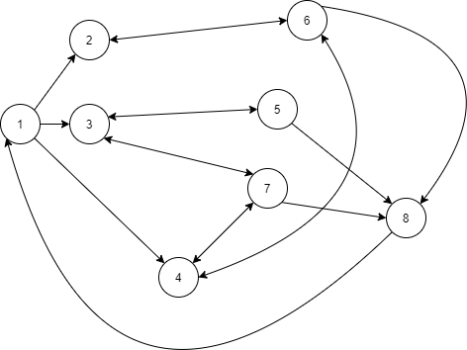
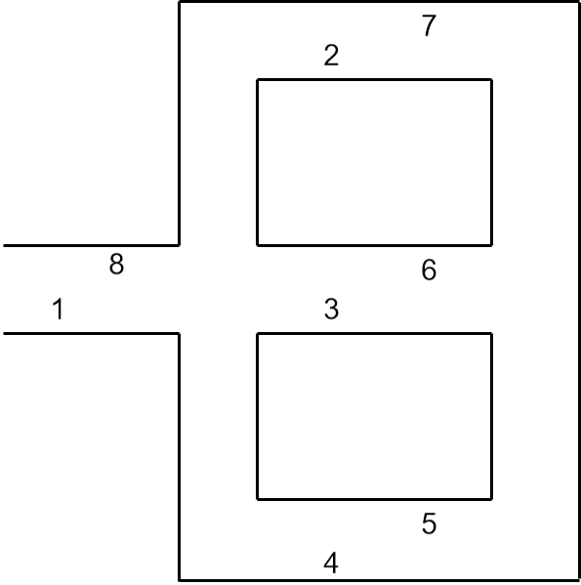
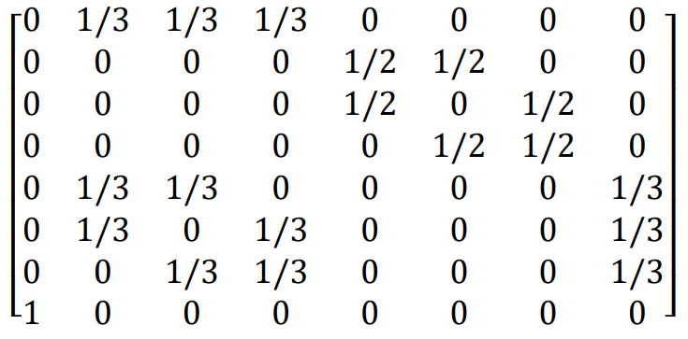
Markov Model

Slide 18
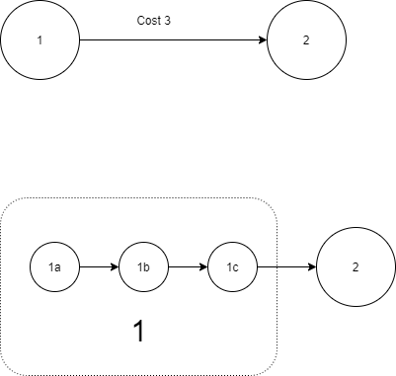
Travel time
Reward sync
Step sync

Slide 19
GreatSPN
Modelling, validation and performance evaluation
Generalized Stochastic Petri Nets with extensions
User friendly GUI
Documentation out of date

Slide 20
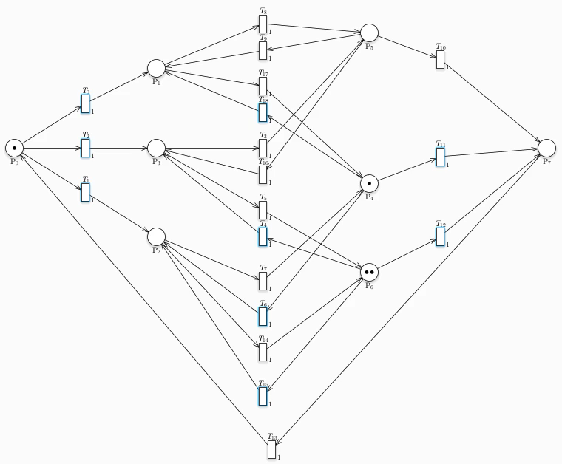
Petri Net

Slide 21
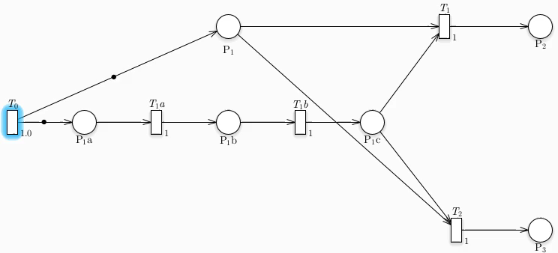
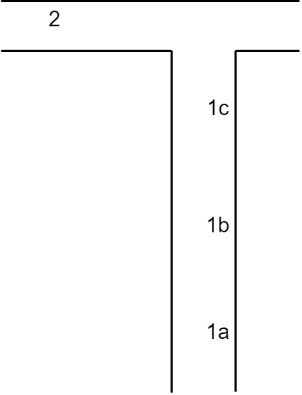
Petri Net : Distance
3

Slide 22
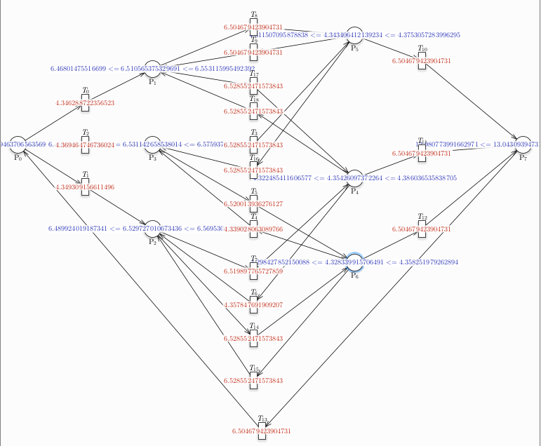
Place distribution

Slide 23
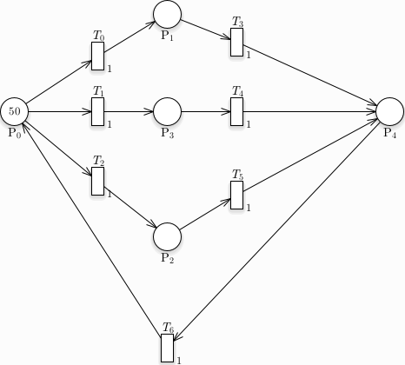
Rate : problem

Slide 24
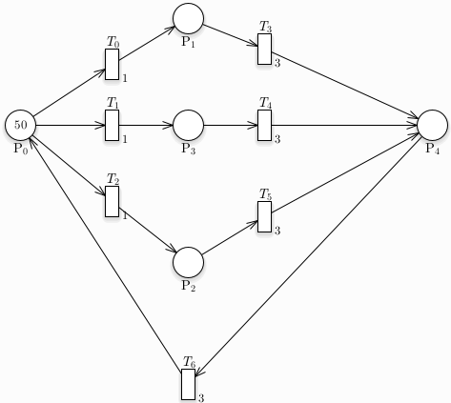
Rate : solution

Slide 25
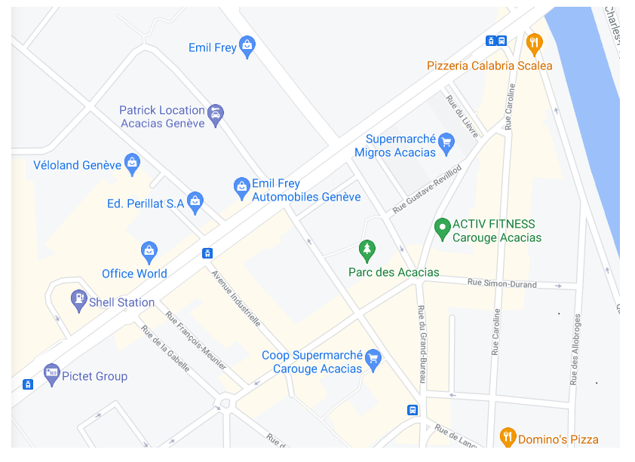
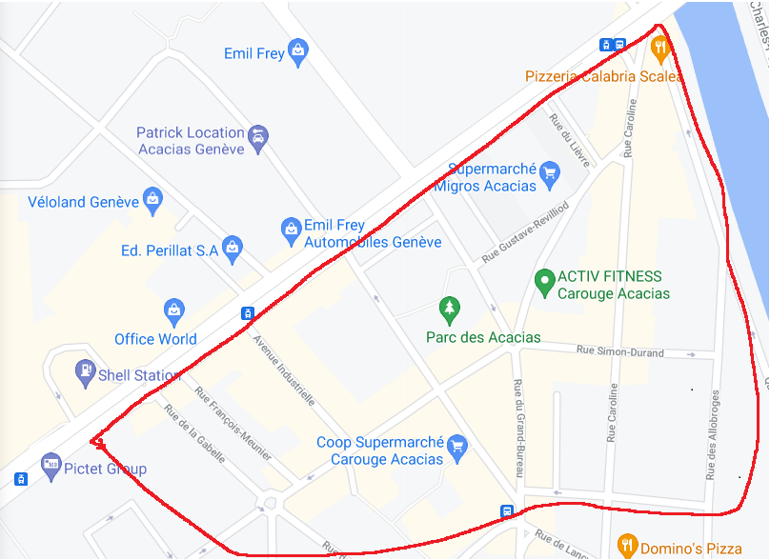
Map

Slide 26
Map
38
37
25
36
11
31
33
30
35
26
9
10
32
24
23
34
21
22
29
28
8
7
15
4
16
20
3
6
12
5
14
17
13
19
0
2
18
1

Slide 27
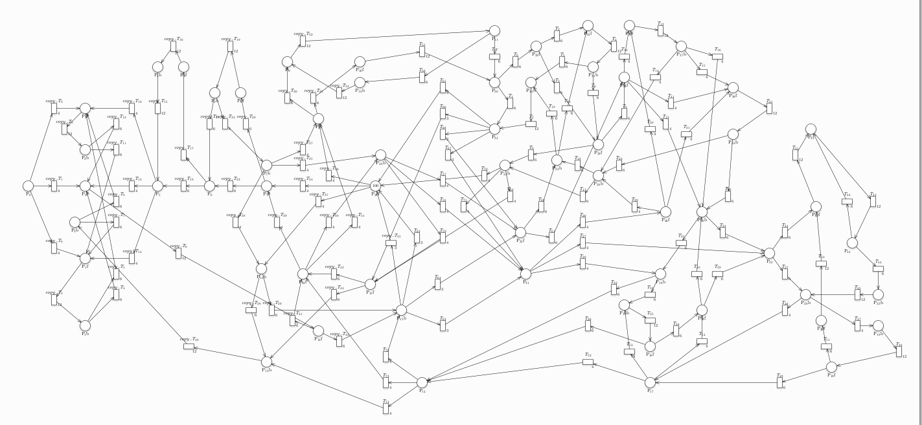
Petri Net

Slide 28
Average token in places

Slide 29
Map : Overload
38
37
25
36
11
31
33
30
35
26
9
10
32
24
23
34
21
22
29
28
8
7
15
4
16
20
3
6
12
5
14
17
13
19
0
2
18
1

Slide 30
Map : Low traffic
38
37
25
36
11
31
33
30
35
26
9
10
32
24
23
34
21
22
29
28
8
7
15
4
16
20
3
6
12
5
14
17
13
19
0
2
18
1

Slide 31
Random insertion : why
More diversity
Each car can reach every places
Closer to real situation

Slide 32
Random insertion : how
Global «Exit-Entry place»
All exiting cars go in the «Exit-Entry place»
Random insertion (high rate) : to keep cars on the road

Slide 33
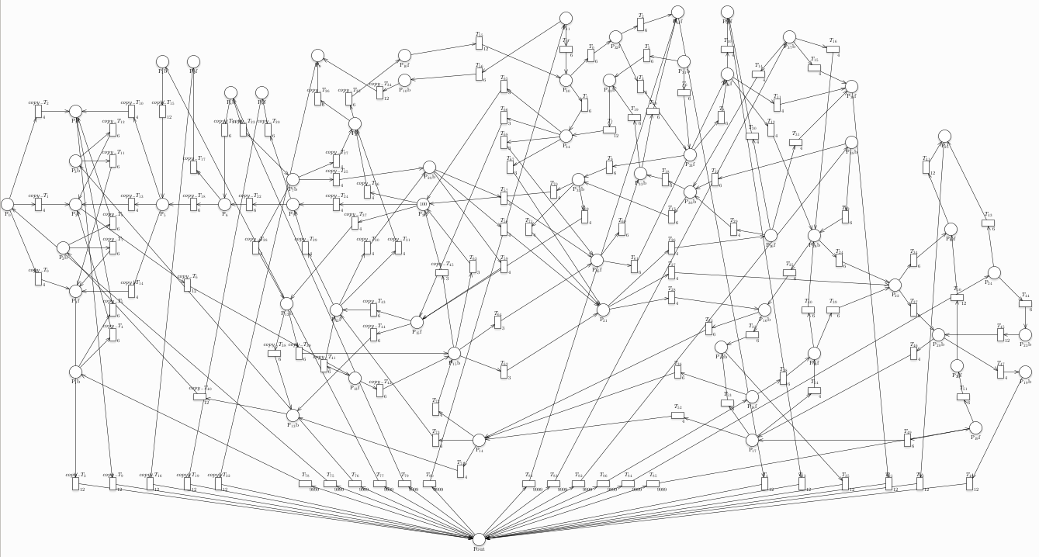
Random insertion : Petri Net

Slide 34
Results

Slide 35
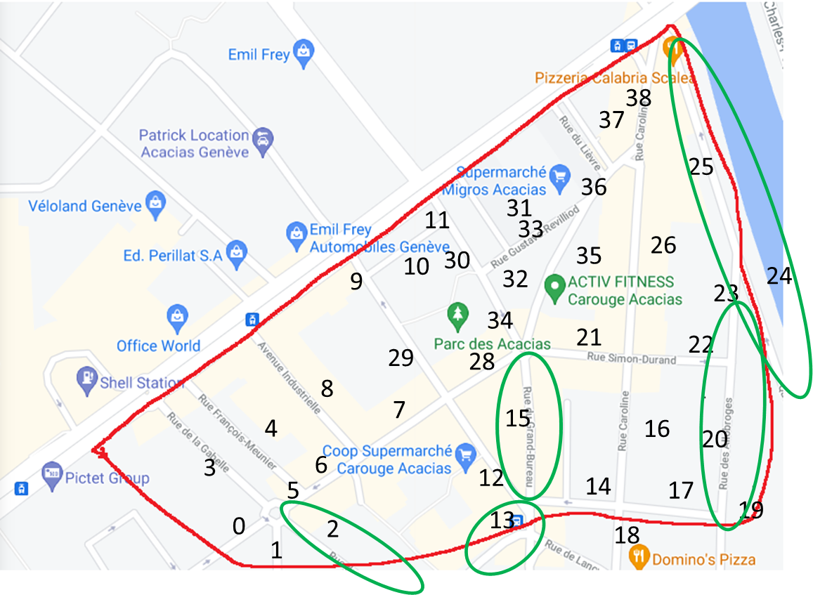
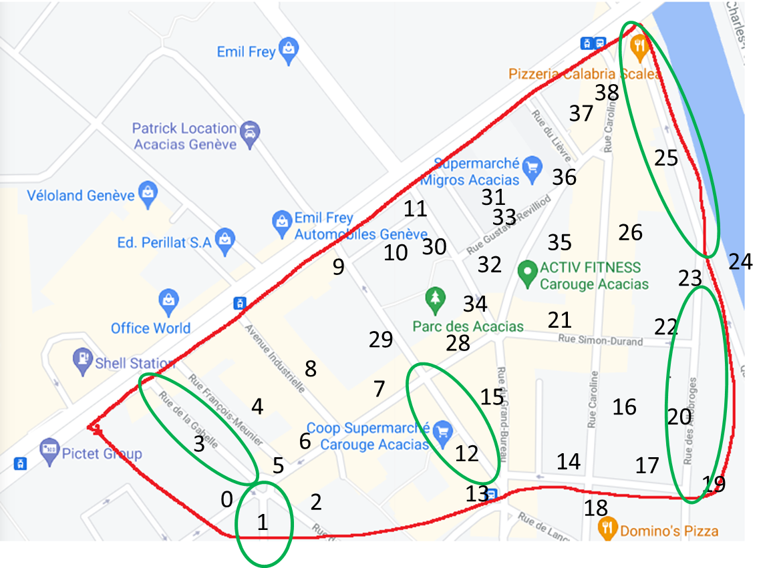
Map : Overload
Before
After

Slide 36
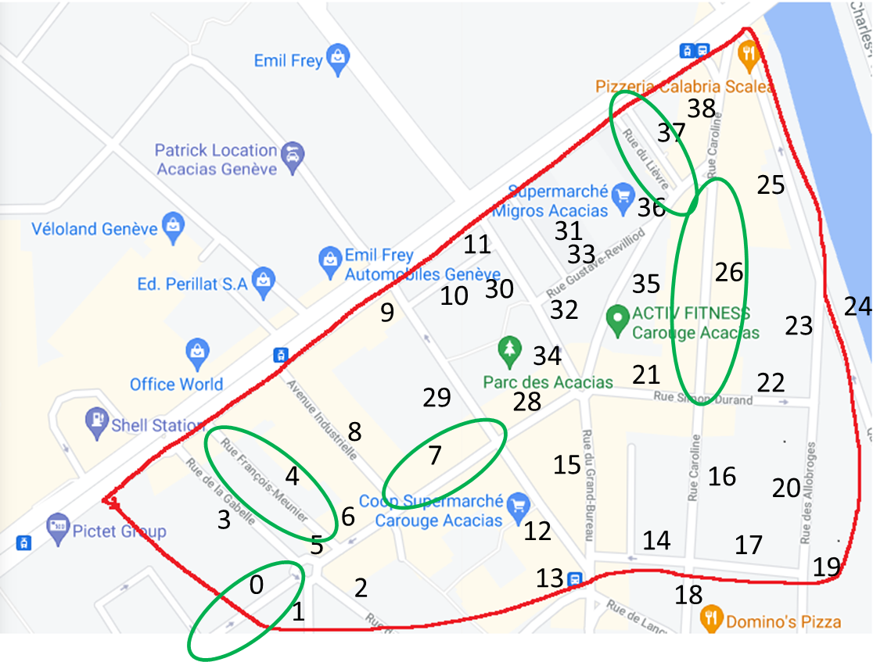
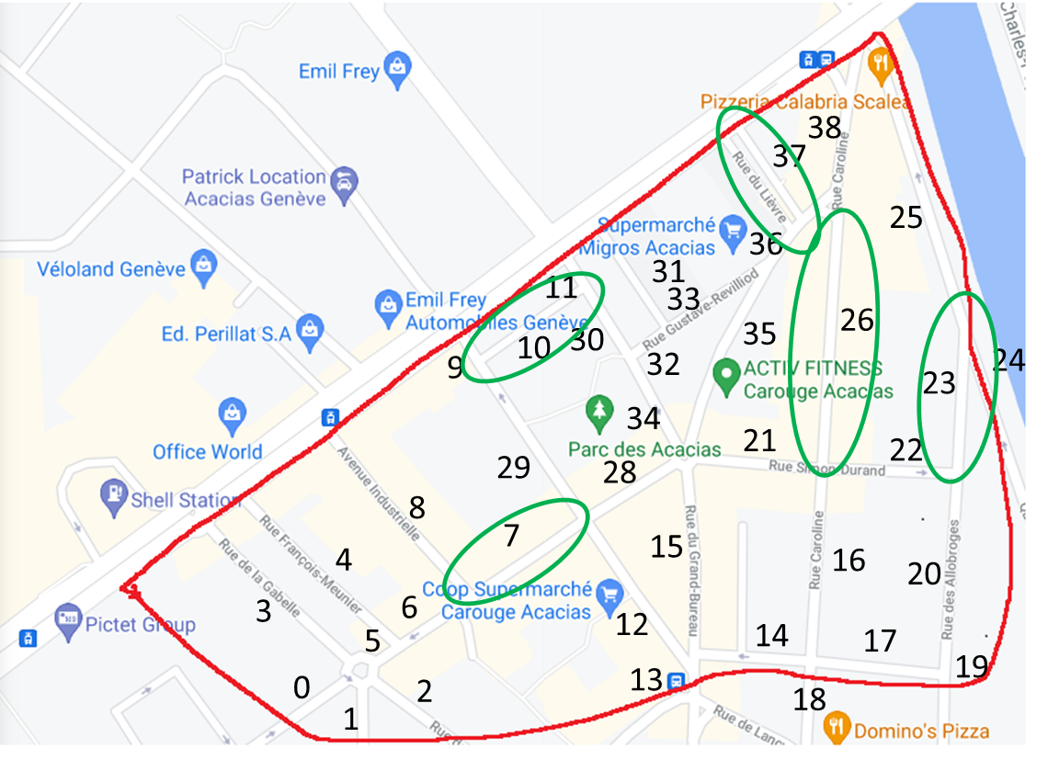
Map : Low traffic
Before
After

Slide 37
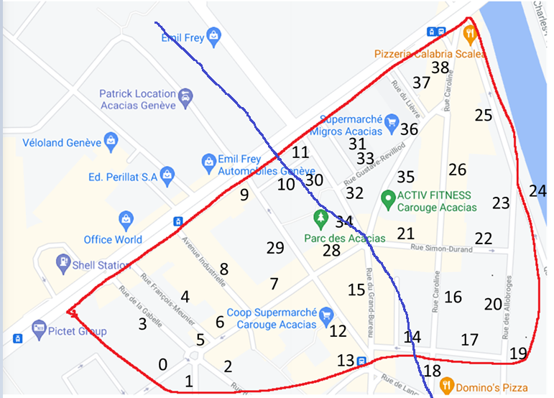
Local analysis
Model complexity
Time complexity
Evaluate random reinsertion

Slide 38
Local analysis : left part
Global
Local

Slide 39
Local analysis : left part
Average error : 0.15
Total error : 4.373
Average connector error : 0.358
Total connector error : 2.51

Slide 40
Local analysis : right part
Global
Local

Slide 41
Local analysis : right part
Average error : 0.088
Total error : 3.088
Average connector error : 0.916
Total connector error : 0.083

Slide 42
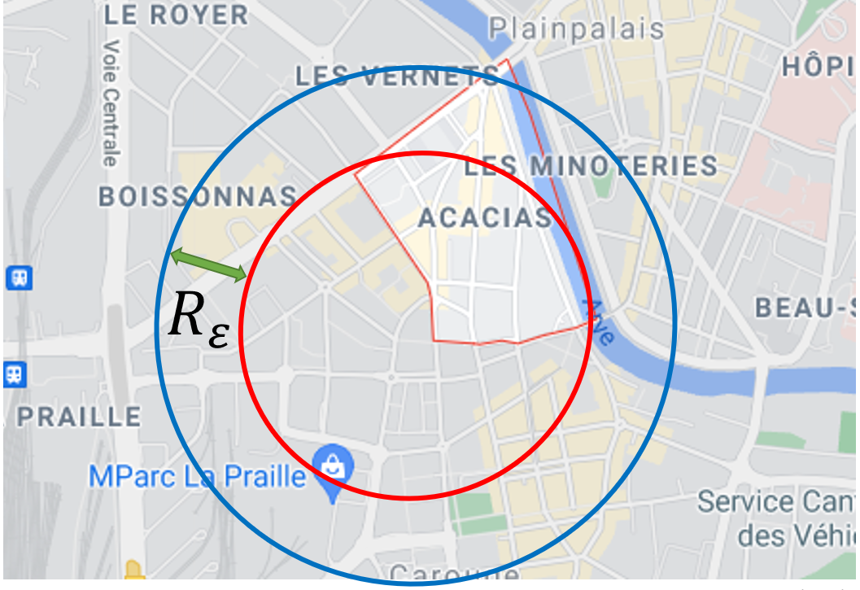
Mitigate border error

Slide 43
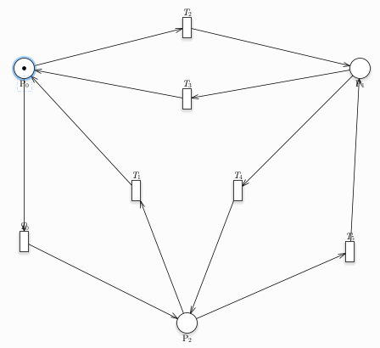
Complexity Analysis : Model
Complete Petri Nets
5000 iterations for each batch
1% error
Multiple executions with random seeds

Slide 44
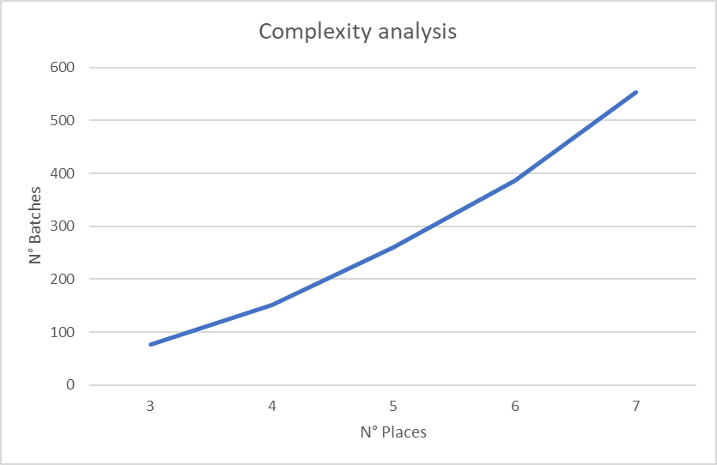
Complexity Analysis : Results

Slide 45
Complexity Analysis : Results

Slide 46
Further Work
Compare results with real data
Solve traffic overload
Better parameter estimation for local analysis
Add notion of travel time

Slide 47
Conclusion
Probabilistic model checking is not suited for all problems
GreatSPN is a powerfull tool for non-deterministic analysis
Better documantion would allow better analysis
Petri nets seems a useful tool for vehicular traffic analysis but a lot of research still need to be done on this topic.

Slide 48
Github
https://github.com/TommasoPeletta/Probabilistic-Model-Checking-with-PRISM

Slide 49
Vehicular Network Analysis Using Probabilistic Model Checking
Jonathan Lo, Tommaso Peletta
3 Juin 2021

